Slide 1
Scripps Ocean Acidification Real-Time (SOAR) Monitoring Project using OSDT Android SensorPod
Peter Shin, Tony Fountain, Sameer Tilak, Thaddeus Trinh
(Qualcomm Institute)
Susan Kram, Jennifer Smith
(Scripps Institute of Oceanography)
University of California, San Diego

Slide 2
What are some of the big issues?
Climate change:
Ocean acidification
Temperature increases
Variability in weather dynamics
Food and water security and sanitation:
Threats to the food chain by long-term processes
Disasters caused by combination of poor planning, poor execution, and poor timing, e.g., floods, typhoons, fires, nuclear accidents,…
Many problems are a combination of bad decisions and unfortunate circumstances. Maybe we can help…

Slide 3


Open Source DataTurbine Initiative: Why? How? Who?
Challenge: How to develop technologies and design systems that will enable timely data collection to inform rational decisions and policies?
Mission of the Open Source DataTurbine Initiative:
To Empower the Scientific Community with Streaming Data Cyberinfrastructure for Environmental Monitoring.

Slide 4
Open Source DataTurbine Initiative What do we do?
Software development and publishing:
DataTurbine middleware for streaming data applications
OSDT Android SensorPod:
Smart controller (gateway note/cluster head) for wireless sensor networks
Cloud computing:
Virtualization of services for data, analytics, and decision support
Systems design and applications development:
End-to-end (sensors to user) cyberinfrastructure that is scalable, robust, efficient, and affordable.

Slide 5
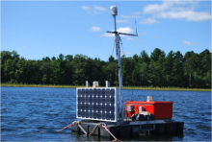
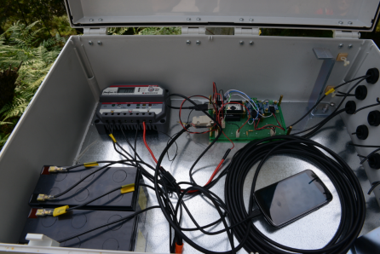
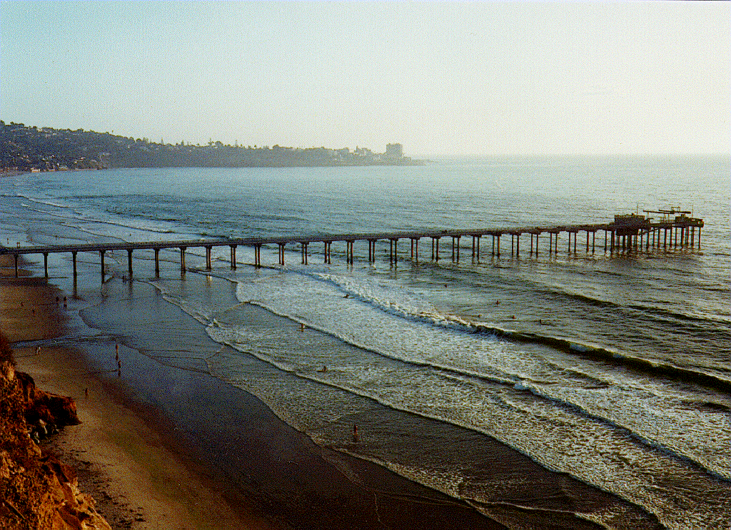
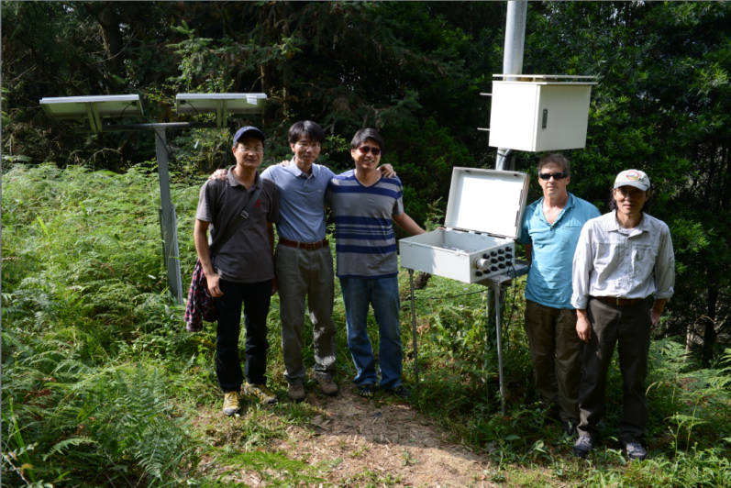
Collaborations and Applications

Slide 6
What is Ocean Acidification?
Ocean Acidification (OA):
man-made process of increasing in acidity of the ocean body
result of increasing amount of carbon dioxide dissolving into the ocean water
Effects of OA:
can act like osteoporosis for marine organisms
ones that build shells or have external skeletons such as mussels, oysters, clams, coral, and many others.

Slide 7
Scripps Ocean Acidification Real-Time (SOAR) Monitoring Project
Motivation:
Currently the scientific community does not know much about OA in coastal regions, most data collection has been done in open waters.
Launched SOAR Monitoring Project in March 2013
Collaboration between Cyberinfrastructure lab in Qualcomm Insititute and the Smith Lab at Scripps Institute of Oceanography
Employed SensorPod to set up a deployment at Scripps Pier to establish a long term OA monitoring program.
The Scripps deployment has the potential for becoming an industry standard for coastal pH monitoring.

Slide 8
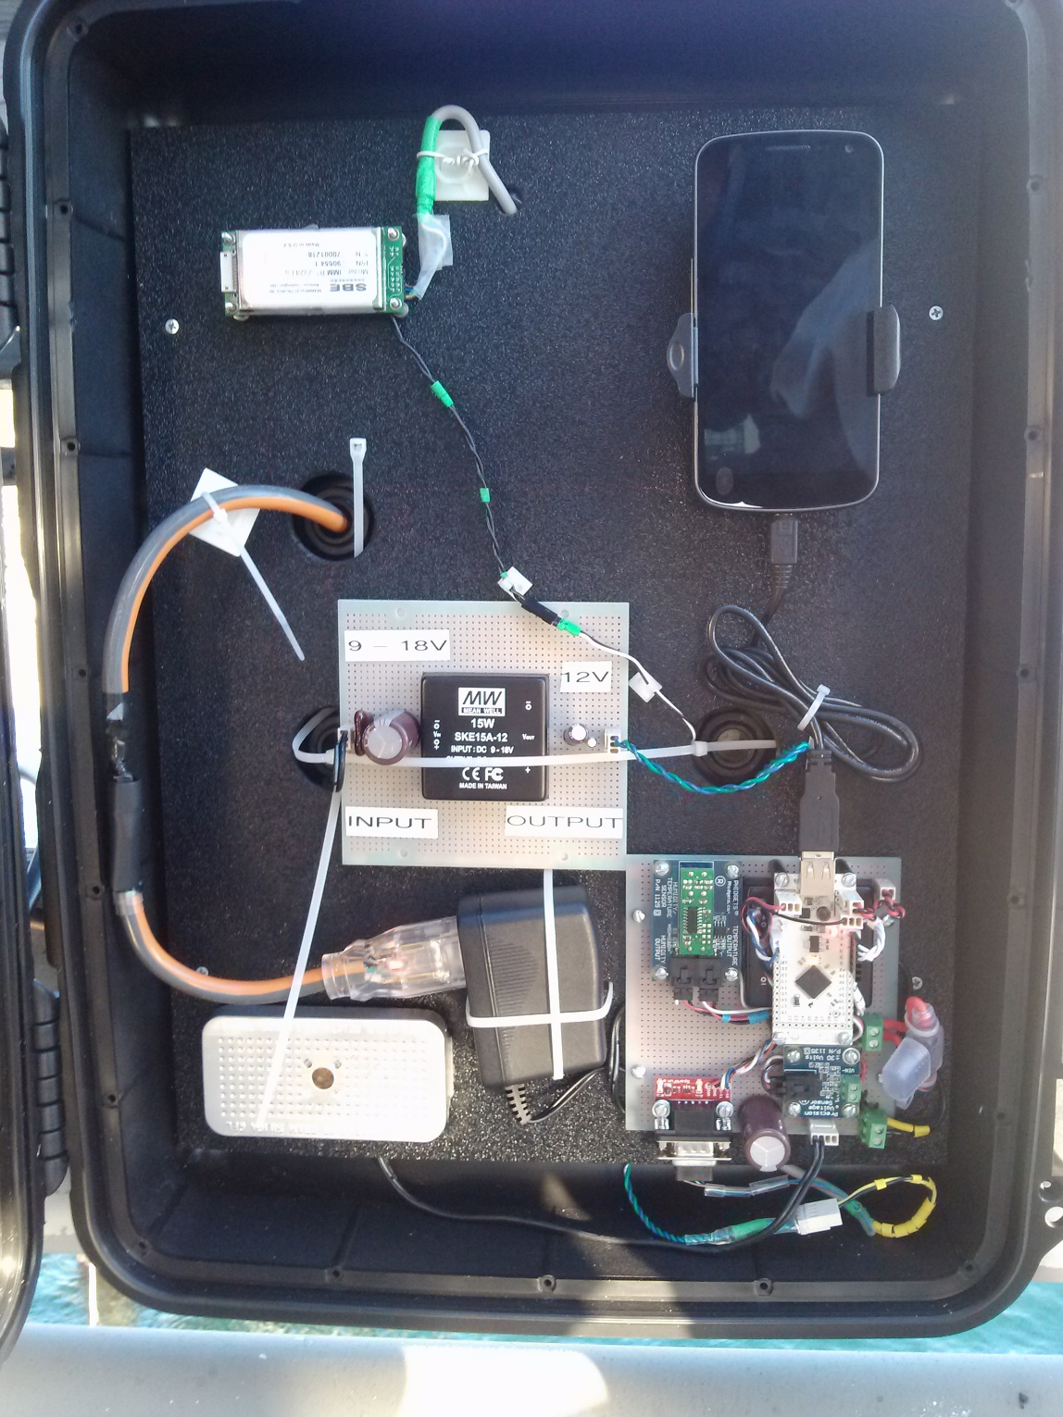


OSDT Android SensorPod at SOAR Monitoring Project
Custom hardware and software that integrates:
Sensors
Smart Phones
Networks: wired and wireless, cellular, Wi-Fi, satellite
Clouds (OSDC, Amazon EC2)

Slide 9

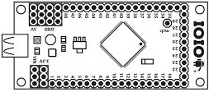





OSDT Android SensorPod System Architecture
OSDT Android SensorPod
Sensor
Protocol Converters
Power Supply
Sensor
IOIO Board
Android Phone
OSDT
OSDT
Sensor
On-board sensors
Dropsync
DT2SM
If This Then That

Slide 10
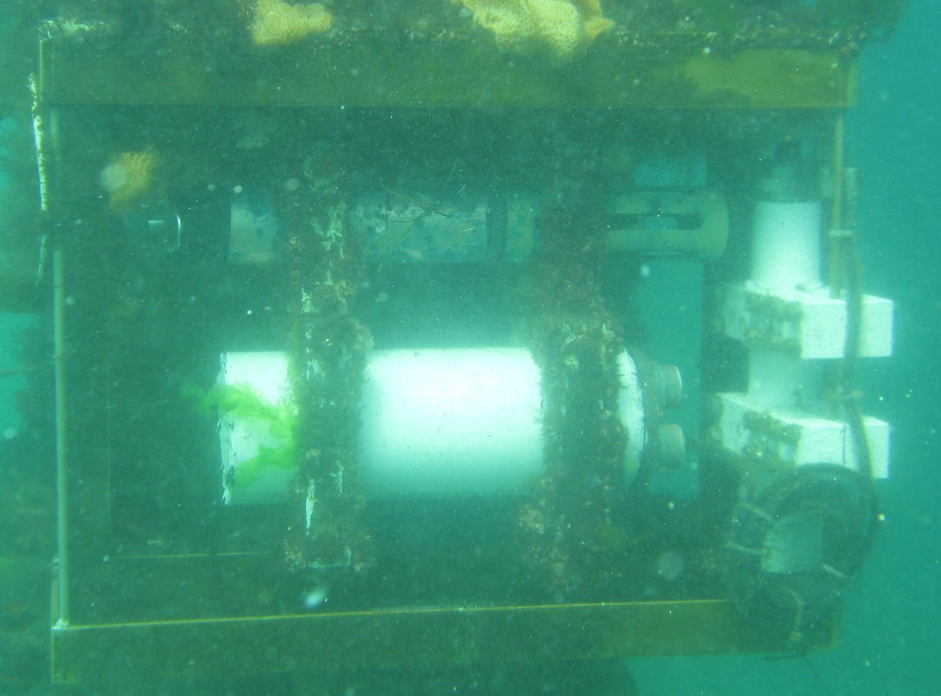
SensorPod System at Scripps Pier
OSDT Android SensorPod
SeaFET and SBE44 (underwater sensor and underwater Inductive Modem)
OSDT
DT2SM
If This Then That

Slide 11
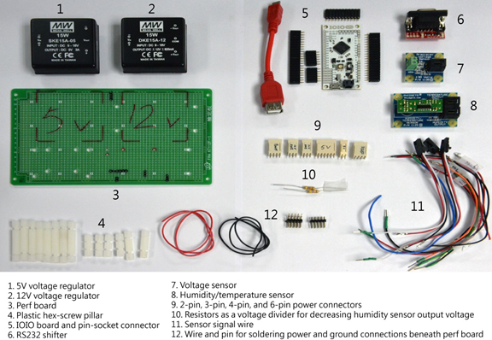
OSDT Android SensorPod Kit

Slide 12
SensorPod Kit?
What is SensorPod kit?
Packaging of SensorPod components that can be assembled to produce a functional SensorPod system
Designed to be relatively quick and easy to assemble from common and inexpensive Commercial Off-The-Shelf (COTS) components with detailed assembly instructions
Why did we build a kit?
Allows the scientists to build and deploy an infrastructure tailored to their needs
Frees site managers and research programs from proprietary components - avoids commercial and vendor lock-in

Slide 13
Typical Data Flow in SensorPod System

Slide 14
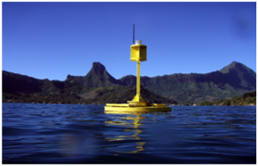
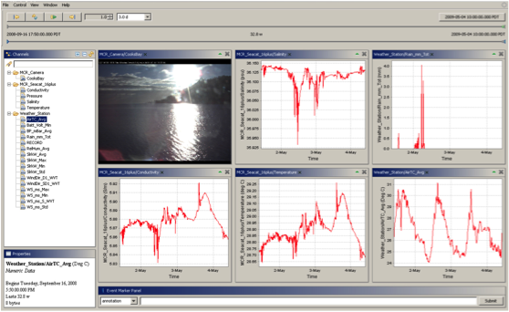
DataTurbine in a Nutshell
Robust real-time streaming data engine
Stream live data from experiments, labs, web cams and even Java enabled cell phones
Acts as a "black box" to which applications and devices send and receive data
Scalable – runs on everything from embedded devices to supercomputers
Open source and freely available
www.dataturbine.org

Slide 15
DataTurbine Middleware
DataTurbine middleware integrates the disparate elements of complex distributed real-time applications.

Slide 16
Design Goals of SensorPod
Flexible
Robust
Efficient

Slide 17
Flexible
Supports various data center scenarios:
distributed, centralized, and cloud data management models.
Provides an abstraction to sensors
no standard to communicate with sensors.
The manufacturers typically offer their sensors with a set of commands with some specific corresponding responses for their digital sensors.
abstraction in the configuration file
Determine the expected timing window.
Add and remove the sensors easily.

Slide 18
Flexible
Customized sampling time for each sensor.
Supports strict timing schedule for each sensor.
The mean jitter has been around 7 ms. The max jitter time was 9 ms.
The multi-threaded applications are controlling the sensors, and sensors can sample at specified time – same or different.

Slide 19
Efficient
Maintain precise sampling time
Minimize the jitter
Foreground service to support the strict timing constraints.
Calculates the sleep time based on its next sampling time, instead of busy waiting.
Notes:
The series of events shown on the timeline explains how the scheduler operates. First, at 8:00:00-000, the thread was supposed to wake up to sample. Instead, the thread wakes up 7 ms later, creating a 7 millisecond jitter. This jitter should be minimized and the designer of the system should assess whether this duration falls within the required time constraint.
After the thread wakes up, it then operates for 1.993 seconds, during this time, a sample is taken and data is sent for processing and etc. At 8:00:02-000, the scheduler recognize the completion of its task, and calculates the sleep time of 58.000 seconds based on the next scheduled sample time, at 8:01:00-000. The scheduler sends the thread to sleep. The length of sleep time constantly changes from one operation to the other, preventing the drift of sampling time.

Slide 20
Efficient
Modular design in both HW and SW
Choose HW/SW modules
Examples - no satellite in WI, SIO or Taiwan, no local ODST service in the phone
Note: trade-off exists - energy-efficient voltage regulator vs. linear voltage regulator
Management of multi-threaded application
Handle error and recover from it at appropriate levels.
Avoid the escalation of an error.

Slide 21
Robust
Operate autonomously for months.
Monitors the system itself
Handles unknown or unexpected failure
Each SW module is a multi-threaded program implemented in the hierarchical fashion.
The top level thread is a manager thread keeping track of the spawned working threads.
Manager thread handles errors, kills and restarts the working threads at an appropriate level.
If the working threads get an exception or fails, the master threads keeps the handles onto those threads and cleans them up before restarting.

Slide 22
Robust
Automatic restart logic for unexpected reboot.
The Android OS sends out a reboot notification broadcast message after it reboots. Broadcast receiver is an abstract Android OS class. A subclass of this Broadcast receiver is implemented to receive the reboot notification message for the Data Gatherer Service. Upon receiving the message, it starts the Data Gatherer Service. The diagram shows that a user can also start the service through the GUI.

Slide 23
Robust
The diagram depicts the data flow from the Data Gatherer Service to the Data Line Processor Service. Inside the Data Line Processor service, the manager thread monitors the two worker threads: Data Line Processor and the OSDT Error Handler. The Data Line Processor includes a parser and the OSDT source client. If any error occurs in the OSDT operation, the OSDT Error Handler chooses an appropriate action. Because any OSDT operation is a multi-threaded asynchronous network operation, the manager and the OSDT Error handler shares a lock to coordinate its activities.

Slide 24
Robust
Withstand transient communication outages.

Slide 25
Robust
The diagram below shows how the OSDT Error Handler module implements the network recovery mechanism steps.

Slide 26
Demonstration
Demonstrate SOAR Monitoring Project facebook page.

Slide 27



Acknowledgement
Moore Foundation
National Science Foundation
Ellen Browning Scripps Foundation
UCSD

